Slide 1
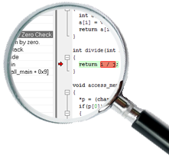
CODE ANALYSIS

Slide 2
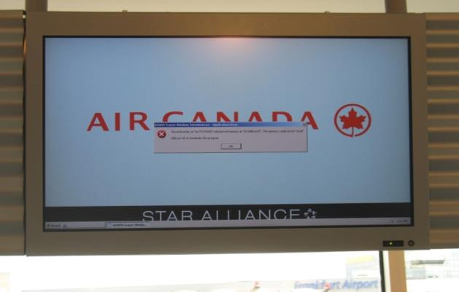
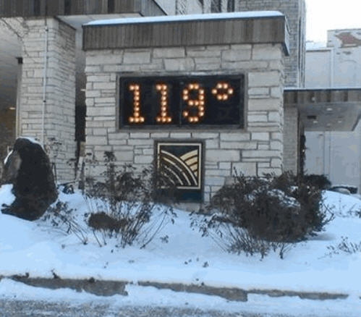

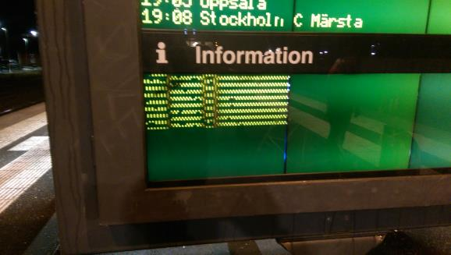
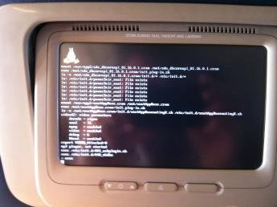
CODE ANALYSIS

Slide 3
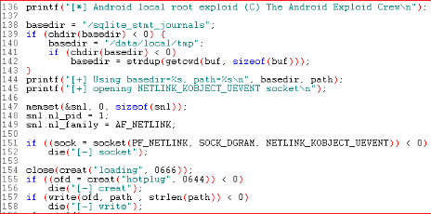

WHY DO WE NEED ANALYSIS TOOLS?
C is not safe
All software contains bugs
The later you find a bug, the more expensive it gets
Cost
Development cycle
3
Notes:
Why are we using C in the first place?
Freedom but will have concequences.
Undefined behaviours.
"C makes it easy to shoot yourself in the foot; C++ makes it harder, but when you do it blows your whole leg off“.
I hope we all can agree on this.
Shortened time-to-market
Budget pressures
Greater awareness of risk from software vulnerabilities
Safety and security
Increased regulatory requirements
➔Focus on testing and quality!

Slide 4
CLASSIC C MISSTAKES
Array out-of-bounds
Null pointer dereferencing
Using variable before initialization
Order of evaluation of operands
Integer overflow
Casting issues
Assignment where check for equality was intended
Illegal printf/scanf format strings
Forgetting to handle a case in switch statement
Passing macro arguments with side effects
4
Notes:
To get rid of these types of mistakes some kind of static analysis is a good start.

Slide 5
WHAT IS STATIC ANALYSIS?
Wikipedia definition:
“Static program analysis is the analysis of computer software that is performed without actually executing programs. The term is usually applied to the analysis performed by an automated tool, with human analysis being called code review.”
5

Slide 6
WHAT IS STATIC ANALYSIS?
A way to statically analyze software...
As opposed to analyzing dynamically
In this context it means analyzing C/C++ source code without compiling or executing the program
Intended to identify potential errors, vulnerabilities, portability issues, coding standards compliance etc.
Highly recommended for any embedded development, mandatory for certification
IAR Systems provides C-STAT
6
Notes:
Static analysis
Either cheap and hard-to-use
Or expensive and hard-to-use...
Integrates badly with existing embedded tools
Traditionally used by QA/Test departments
http://cacm.acm.org/magazines/2010/2/69354-a-few-billion-lines-of-code-later/fulltext

Slide 7
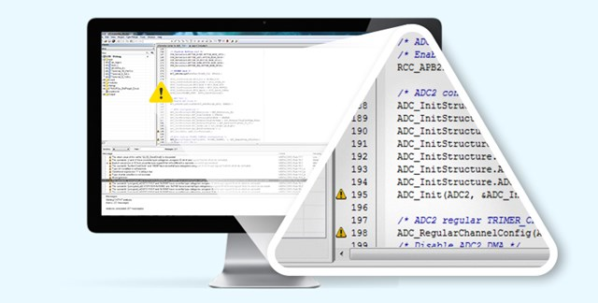
WHAT IS C-STAT?
Static analysis tool
Fully integrated in IAR Embedded Workbench
Generate full or summary reports
Support for export/import of selected checks
Support for command line execution
Includes:
Standard checks
More than 200 additional checks to address issues covered by CWE (the Common Weakness Enumeration), the CERT C coding standard etc.
Categories like Array bounds, Arithmetic errors
MISRA-C: 2004
MISRA-C: 2012
Improved version of the 2004 edition
Support for C99 ANSI-C standard, as well as C90
MISRA-C++: 2008
165 checks to address C++ specific issues
7

Slide 8
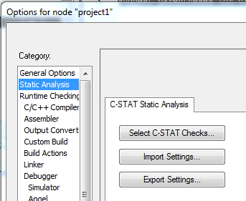
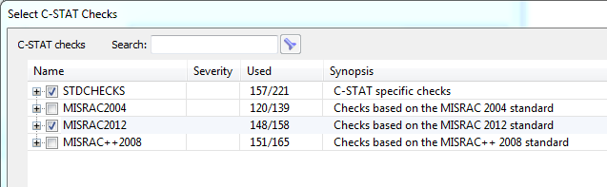
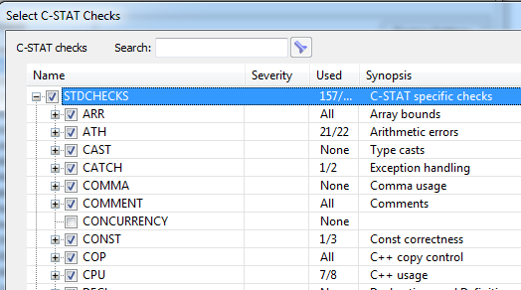
C-STAT STATIC ANALYSIS

Slide 9
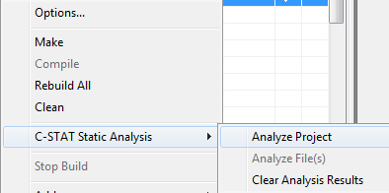
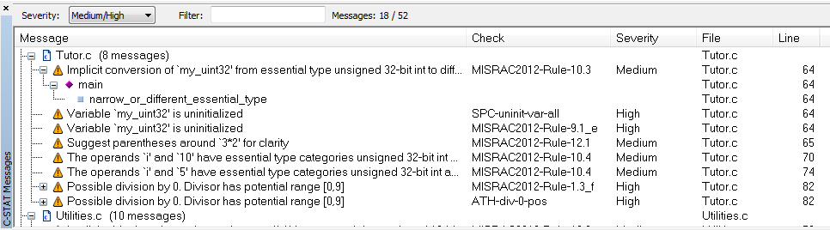
C-STAT STATIC ANALYSIS
Very few false positives
Allows export and import of selected rules
C-STAT can be started from both the IDE or command line
9

Slide 10
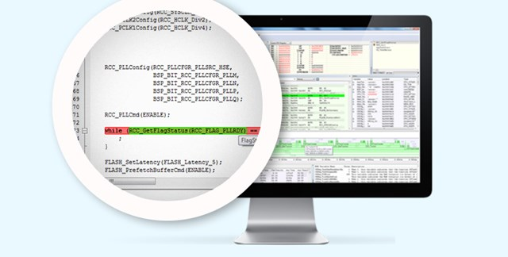
RUNTIME ANALYSIS – C-RUN
Complements static analysis
Detection of data manipulation issues during runtime
Addresses arithmetic, bound and heap checking
Very efficient instrumentation of compiled code
Various options to report detected errors
10
Notes:
Run-time analysis:
Typically expensive, hard-to-use, bad performance, specialized hardware, integrates badly with existing embedded tools
Traditionally used by QA/Test departments

Slide 11
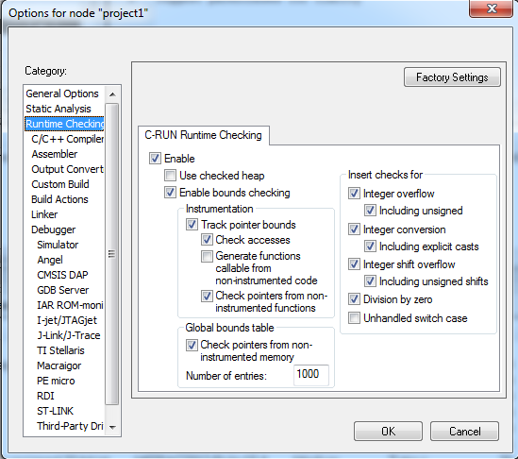
C-RUN RUNTIME ANALYSIS
Individual checks can be turned on/off
Overhead depends on:
Performed checks
Application profile
Can be configured on module basis
11

Slide 12
CODE ANALYSIS TOOLS
Total fault coverage
×
×
×
×
×
×
Runtime analysis
×
×
×
×
×
×
×
×
×
×
×
×
Static analysis
12

Slide 13
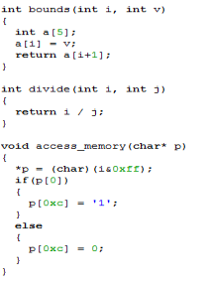
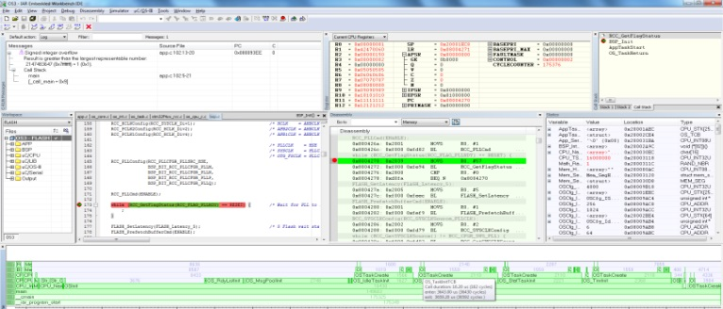



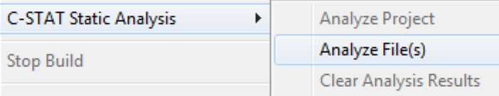
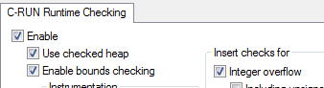




TAKE FULL CONTROL OF YOUR DEVELOPMENT
Implement your design in code
Build and debug the application
Release the application
1000100011100101011100111
00110101110100011001100011110010101111010101100110010101010101101
0100101110010111001111001
100011001100011110010101110011101010110011001
Let C-STAT analyze your code
Let C-RUN analyze your project
Review potential issues
Investigate runtime errors
Requirements
Design
Implementation
Verification
Maintenance

Slide 14
WHY USE C FOR EMBEDDED SYSTEMS?
Widespread knowledge of the language
Virtually every developer knows C, at least to some extent...
Many languages are very similar to C
Widespread tool support for the language
Many different compilers for virtually any target
Many middleware options
Many static analysis tools
Fairly close to hardware
You can abstract to a higher level of interaction with the hardware
You can get all the way down to writing bits to ports
14
Code analysis

Slide 15
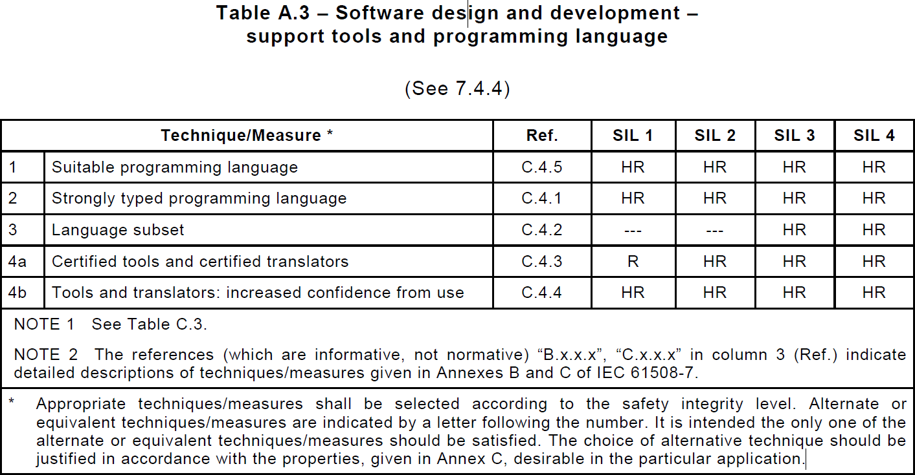
THE IEC61508 STANDARD
Table A.3 of the standard prescribes attributes of a language. For all levels of Safety Integrity Level (SIL), a “suitable programming language” is Highly Recommended.
15
Code analysis

Slide 16
THE IEC61508 STANDARD
The standard gives a description of a suitable language:
The language should be fully and unambiguously defined.
There are ~190 undefined behaviors in C99
The language should be user- or problem-oriented rather than processor/platform machine-oriented.
Well...
Widely used languages or their subsets are preferred to special-purpose languages.
OK, but not more than that
16
Code analysis
Notes:
Anything at all can happen; the Standard imposes no requirements. The program may fail to compile, or it may execute incorrectly (either crashing or silently generating incorrect results), or it may fortuitously do exactly what the programmer intended.
Division by zero
Reaching the end of a value-returning function (other than main()) without a return statement may result in undefined behavior
It is undefined behavior to cast an int* to a float*
Shift overflow
Signed integer overflow (int_max + 1)?
“Somebody once told me that in basketball you can’t hold the ball and run. I got a basketball and tried it and it worked just fine. He obviously didn’t understand basketball.”
Of course it is physically possible to pick up a basketball and run with it. It is also possible you will get away with it during a game. However, it is against the rules; good players won’t do it and bad players won’t get away with it for long. Evaluating (INT_MAX+1) in C or C++ is exactly the same: it may work sometimes, but don’t expect to keep getting away with it.

Slide 17
AND IT GOES ON...
The IEC 61508 standard continues:
The language should encourage:
The use of small and manageable software modules;
Restriction of access to data in specific software modules;
Definition of variable subranges; and
Any other type of error-limiting constructs.
17
Code analysis

Slide 18
IEC 61508 STANDARD
With the right C subset and use of static analysis tools, C can be a Highly Recommended standard for all 4 levels of SIL.
One possible subset: MISRA-C…
18
Code analysis

Slide 19
MISRA C DEFINITION
Motor Industry Software Reliability Association
A consortium promotes standards to improve the safety and reliability of embedded code.
More importantly, MISRA C is:
A C language subset
Takes out the undefined behavior of C
A basis for a coding standard
Add your own coding standard, cover deviations, modularization, variable range control, use of intrinsic functions, language extensions etc…
19
Code analysis
Notes:
MISRA C stands for the Motor Industry Software Reliability Association, a consortium based out of Cambridge in the UK that promotes standards to improve the safety and reliability of embedded code.

Slide 20
EXAMPLES OF MISRA C RULES
No use of native primitive (”plain”) types like int, float, char, etc.
The size and signedness of these types is different on sundry MCUs
Instead, use types like uint16_t that explicitly tell other developers the size and signedness you intend
8-bit machine
typedef unsigned char uint8_t;
typedef int int16_t;
typedef unsigned long uint32_t;
32-bit machine
typedef unsigned char uint8_t;
typedef short int16_t;
typedef unsigned int uint32_t;
<stdint.h>
20
Code analysis

Slide 21

EXAMPLES OF MISRA C RULES
Loops and conditional statements are required to have code blocks encapsulated in { }
if (exp) then { statement; } else { statement; }
if(a > 10)
foo_1();
foo_2();
if(a > 10)
foo();
if ((err = SSLHashSHA1.update(&hashCtx, &signedParams)) != 0)
goto fail;
goto fail;
21
Code analysis

Slide 22
EXAMPLES OF MISRA C RULES
Implicit conversions are not allowed
uint16_t i = 1; /* ? */
uint16_t i = 1u; /* Definitely intend to be unsigned */
22
Code analysis

Slide 23
CONFUSING IMPLICIT CASTING
Bit shift an unsigned 32 bit object 15 times (AVR 16-bit int)
uint32_t a = 0;
a = (1 << 15);
a = 0xFFFF8000
uint32_t b = 0;
b = (1u << 15);
b = 0x00008000
(1 << 15) performed as signed integer → 0x8000 = - 32768
Casted to signed long preserving value -32768 → 0xFFFF8000
Casted to unsigned long → 0xFFFF8000
The C Standard 6.3.1.1:
If an int can represent all values of the original type, the value is converted to an int; otherwise, it is converted to an unsigned int. These are called the integral promotions.
23
Code analysis

Slide 24
EXAMPLES OF MISRA C RULES
There shall be no definitions of objects or functions in a header file
File foo.h:
int myGlobal; /* Creates an instance
for each inclusion of foo.h! */
Different linkers treat this differently... You might get multiple static copies of the variable!
Or multiple overlaying copies... →A change of tool chain will probably create chaos!
24
Code analysis

Slide 25
EXAMPLES OF MISRA C RULES
The operands of a logical && or || shall be primary expressions.
Example of a rule violation
a && b || c
a || b && c
a == 3 || b > 5
Examples of correct code
(a && b) || c
(a || b) && c
(a == 3) || (b > 5)
25
Code analysis

Slide 26
EXAMPLES OF MISRA C RULES
When an array is declared with external linkage, its size shall be stated explicitly or defined implicitly by initialization.
Example of a rule violation
extern int16_t array[];
Examples of correct code
int16_t array2[10];
int16_t array2[] = { 1, 2, 3 };
26
Code analysis

Slide 27
EXAMPLES OF MISRA C RULES
The right hand operand of an && or || operator shall not contain side effects
if((a==b)&&(c--)){...}
c is only decremented if a equals b
A small taste of rules...
27
Code analysis

Slide 28
MISRA C
Should be used from the beginning
Rule by rule in current code
If some rule does not fit your need, don’t use it, but document why.
Recommended in IEC 61508
Often good to use even when not mandatory
“It is a set of guidelines, not a religion”
28
Code analysis
Notes:
Built in to Embedded Workbench, so it is simple to use
Don’t go out of your way to blindly support each and every rule
Some rules may not play well with specific hardware
Some well-tested and reused algorithms in your code may not jibe with some MISRA rules
Try to isolate and document each MISRA rule deviation
This forces you to analyze what you’re doing and why
Helps when you come back to the project for a follow-on years later and don’t understand why you made the decisions you did
If you’re trying MISRA with legacy code, see rule #1 above
Don’t go all in!
Work with one rule at a time
Select the easy rules first...
A set of rules that if followed reduce the risk of some errors
Must be used in some cases
Often good to use even when not mandatory
Recommended in IEC61508
Should be used from the beginning, not as an add-on
“It is a set of guidelines, not a religion”
If some rule does not fit your need, don’t use it, but document why.

Slide 29
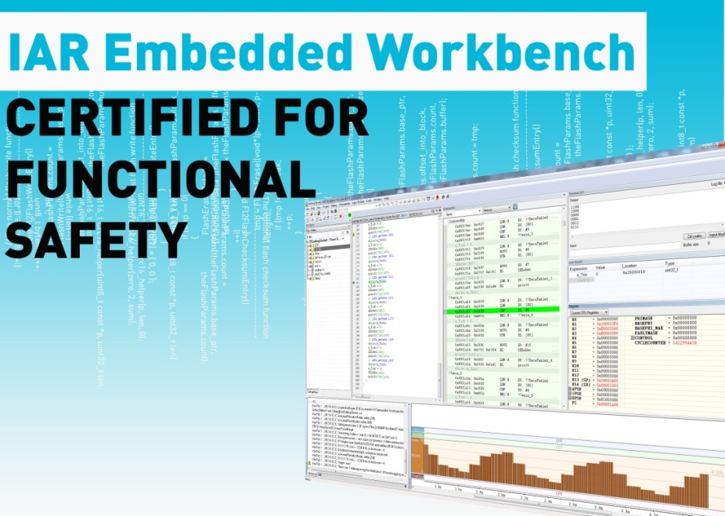

CERTIFIED TOOLS FOR FUNCTIONAL SAFETY
The Functional Safety versions of IAR Embedded Workbench for ARM, Renesas RX and RL78 includes:
Functional Safety certificate from TÜV SÜD
Safety report from TÜV SÜD
Safety guide
Prioritized support
Validated service packs
Regular reports of known problems
Validated EN 50128 (ARM) IEC 61508 ISO 26262
29

Slide 30
CERTIFIED TOOLS FOR FUNCTIONAL SAFETY
In addition to what is included in standard Product and SUA the following is also included in the FS product:
Functional safety certificate from TÜV covering IEC 61508 and ISO26262 (EN50128)
Safety report from TÜV
Safety Guide
Support for a frozen version
Validated Service Packs on the frozen version
Regular reports of known problems
Prioritized support
30

Slide 31
DEMO
C-STAT & C-RUN

Slide 32
SUMMARY

Slide 33
C-STAT & C-RUN
Fully integrated into IAR Embedded Workbench
Ease-of-use!
Ease-of-use!
Ease-of-use!
Code size and speed performance
To be used in the daily development work
Can of course also be used for daily builds etc
Complements traditional unit test tools
Finds errors that can be extremely hard/time consuming to find

Slide 34
THE STACK

Slide 35
THE STACK
The stack is used for:
Local variables
Return addresses
Function arguments
Compiler temporaries
Interrupt contexts
Life span is the duration of the function
heap
SP
stack
global/static variables
35

Slide 36
STACK OVERFLOW
Stack overflow
there is no protection on SP
the stack grows into the global area overwriting application data
corrupted variables
wild pointers
corrupted return addresses
Errors are really hard to catch!
Setting the stack size
too small - overflow
too big - waste of memory
heap
stack
stack
SP
danger zone!
SP
global/static variables
global/static variables
36

Slide 37
AVOIDING STACK OVERFLOW
Test and measurement methods
Track the stack pointer
Use stack guard zones
Fill the stack area with an arbitrary bit pattern
Calculation methods
Manual calculation
Static stack calculation tool
37
Notes:
Create a poll or interrupt function that reads the stack pointer.
Check the guard zone
Data breakpoint

Slide 38
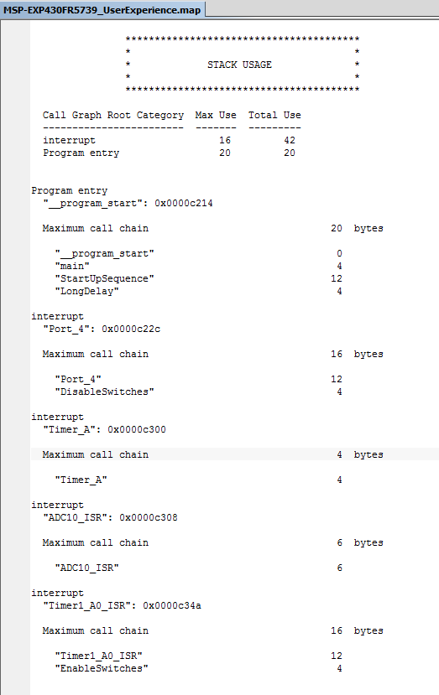
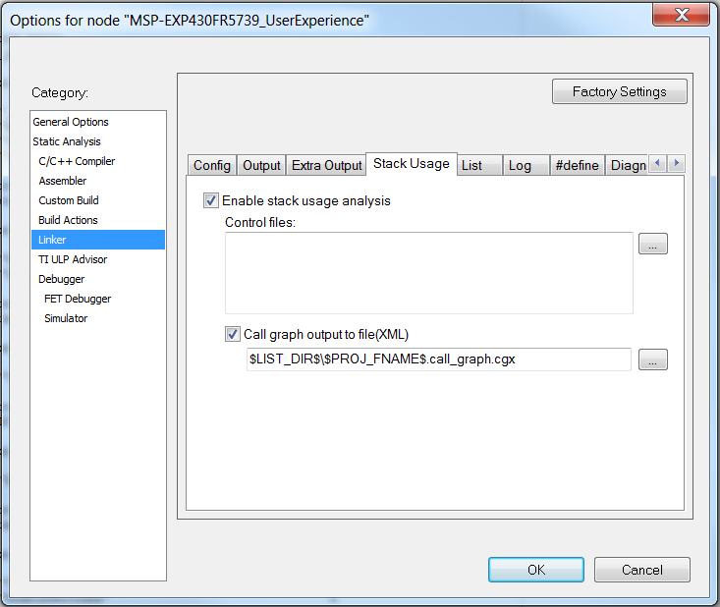
STACK USAGE ANALYSIS

Slide 39
WAYS TO SAVE ON STACK
Avoid printf() and its relatives…
Pass by reference instead of by copy
At least for objects of size greater than the register size
Limit the number of arguments to a function
The ABI of an MCU tells a compiler how many arguments can be passed in the registers, all others must be passed on the stack
void doThisOrThat(…,doWhat); → void doThis(…); void doThat(…);
39

Slide 40
WHY SHOULD YOU USE
A CODE ANALYSIS TOOL?

